Slide 1
Db2 Auditing
Speaker: Vaisakh Gopal
IBM Advanced Db2 Support
vaisakh.gopal@ibm.com

Slide 2
-To protect against and discover unknown or unacceptable behaviors, you can monitor data access by using the Db2 audit facility. -Predefined set of events that are logged to disk when they occur -8 categories gather the events into manageable groups -can be enabled at both instance and database level -Archive and extract allows you to manage and view the logs -Output can be redirected to a text file or delimited file -Success and Failures can be audited -Captures WHEN,WHERE,WHAT,WHO
Audit Overview

Slide 3
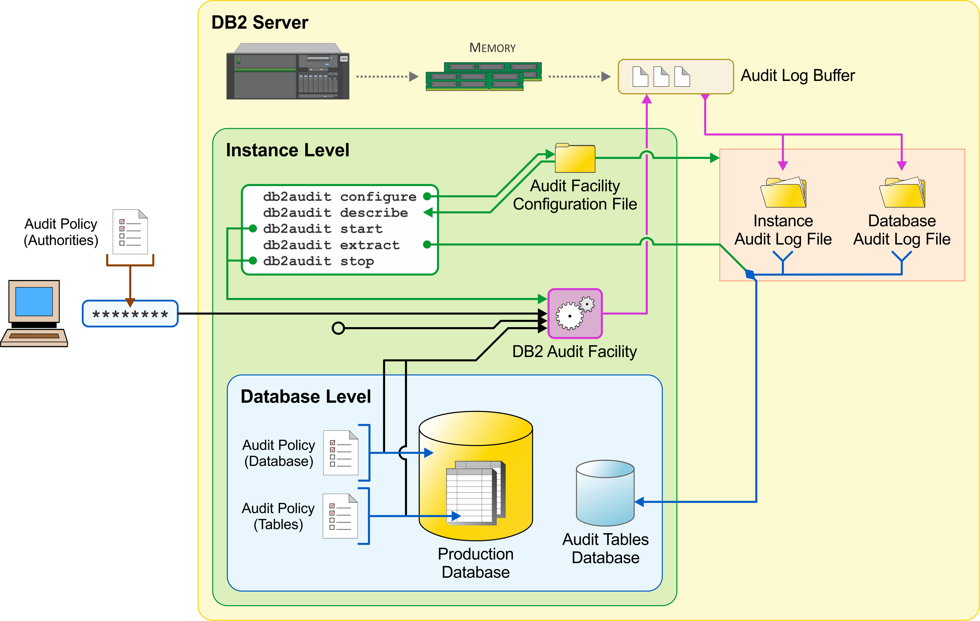
Audit Architecture

Slide 4
-Audit (AUDIT). Generates records when audit settings are changed or when the audit log is accessed. -Authorization Checking (CHECKING). Generates records during authorization checking of attempts to access or manipulate Db2 database objects or functions. -Object Maintenance (OBJMAINT). Generates records when creating or dropping data objects, and when altering certain objects. -Security Maintenance (SECMAINT). Generates records when: -Granting or revoking object privileges or database authorities -Granting or revoking security labels or exemptions -Altering the group authorization, role authorization, or override or restrict attributes of an LBAC security policy -Granting or revoking the SETSESSIONUSER privilege -Modifying any of the SYSADM_GROUP, SYSCTRL_GROUP, SYSMAINT_GROUP, or SYSMON_GROUP configuration parameters. -System Administration (SYSADMIN). Generates records when operations requiring SYSADM, SYSMAINT, or SYSCTRL authority are performed.
Audit Categories

Slide 5
-User Validation (VALIDATE). Generates records when authenticating users or retrieving system security information. -Operation Context (CONTEXT). Generates records to show the operation context when a database operation is performed. -Execute (EXECUTE). Generates records during the execution of SQL statements. Different events audited can be found in https://www.ibm.com/docs/en/db2/11.5.x?topic=layouts-audit-events
Audit Categories

Slide 6
-Auditing within DB2 is configured at two levels -Instance – via db2audit tool -Database – via Audit Policy database objects -Similar categories for each level -Only Audit Policies within the database support fine grained configuration -An audit policy is a database object that holds an instance of the audit configuration Ex. CREATE AUDIT POLICY SENSITIVE_DATA_POL CATEGORIES OBJMAINT STATUS BOTH, SECMAINT STATUS BOTH ERROR TYPE NORMAL; -Can be used within a database to provide granular audit capabilities
Audit Configuration

Slide 7
Audit policies can be associated with a number of database objects to control what is audited -The database itself -Tables -Authorities such as SYSADM, DBADM and SECADM -Users and groups -Roles -Trusted Connections This granularity allows a narrowed focus on exactly what needs to be audited An Audit Policy is associated with a database object using the AUDIT statement Many objects can be audited according to a single audit policy Only one audit policy can be associated with any one object AUDIT AUTHORITY DBADM, ROLE MARKETING USING POLICY SENSITIVE_DATA_POL;
Database Audit Granularity

Slide 8
Configured using db2audit command eg. db2audit configure datapath /auditdata db2audit configure archivepath /archivedata db2audit configure scope sysadmin status both To start, db2audit start To stop, db2audit stop To check current settings db2audit describe
Instance level Auditing

Slide 9
Create audit policy db2 create audit policy patching_audit categories objmaint status both error type audit Audit database using the created policy db2 audit database using policy patching_audit Verify if it’s active db2 "select * from syscat.auditpolicies" db2 "select * from syscat.audituse” To stop the database audit db2 audit database remove policy To drop the policy db2 drop audit policy patching_audit
Database level Auditing

Slide 10
-The Archive command copies the active log file to an archived log file and allows the server to continue logging to a new active log file as soon as possible. -Use of archived audit logs allows subsequent operations such as backup, extraction and deletion to have zero effect on the performance of the server -Archive is available both when the server is running and when it is stopped -Available through db2audit command line tool and stored procedure db2audit archive db2audit archive database <dbname> -db2audit flush can be used to write any pending audit records to the log before doing archive. flush This parameter forces any pending audit records to be written to the audit log. Also, the audit state is reset from "unable to log" to a state of "ready to log" if the audit facility is in an error state.
Audit Archive

Slide 11
Transforms binary audit files to either -syslog -flat file -delimited file eg. db2audit extract file audit_report_db.txt from files db2audit.db.PATCHING.log.0.20260512202728 db2audit extract delasc to /home/db2inst3/auditdata from files db2audit.instance.log.0.20260512193137
Audit Extract

Slide 12
-The extracted delimited audit data is stored in files such as objmaint.del, execute.del etc -Create the tables using the script audit.ddl in misc/db2audit.ddl of product directory -8 tables will be created for each category - Load data of each delimited file into respective tables eg. db2 "import FROM objmaint.del OF DEL LOBS FROM auditlobs commitcount 10000 INSERT INTO OBJMAINT” - Select data db2 "select TIMESTAMP, CATEGORY, EVENT, STATUS,substr(USERID,1,10) USERID,substr(AUTHID,1,10) AUTHID , substr(OBJNAME,1,20) OBJNAME,OBJTYPE ,ALTERACTION, HOSTNAME from OBJMAINT order by 1"
Load Delimited data into audit tables

Slide 13
SYSPROC.AUDIT_ARCHIVE Allows a SECADM to archive the active audit log for the database db2 " CALL SYSPROC.AUDIT_ARCHIVE(NULL, NULL)" SYSPROC.AUDIT_LIST_LOGS Allows a SECADM to list the archived audit logs for the database db2 “SELECT * FROM TABLE(SYSPROC.AUDIT_LIST_LOGS('')) AS T1” SYSPROC.AUDIT_DEL_EXTRACT Allows a SECADM to perform an extract of archived audit logs for the database into a delimited file db2 “CALL SYSPROC.AUDIT_DELIM_EXTRACT(NULL, ‘/home/db2inst1/extractdata’, NULL, '% 20260513013616%’,NULL)”
Audit Stored Procedures

Slide 14
-The performance of audit is very dependent on the type of workload -OLTP has a higher overhead than warehousing -The performance of audit is very dependent on the speed of the disks -Use fast disks -Isolate audit data from other database data on separate disks -Separate active audit log and archived audit logs -Use individual disks for each partition in DPF -Use audit daemon to buffer writes (AUDIT_BUF_SZ > 0) -The performance of audit is very dependent on the number of events generated -Use Audit Policies to only audit what is absolutely necessary -CONTEXT and EXECUTE are the heaviest categories, the others have little impact
Audit Performance

Slide 15

Questions ?

